Slide 1
MINI PROJECT
TCP Server-client based distributive file system
Department of computer science and technology

Slide 2
MENTOR – PROFESSOR MANAS HIRA
Made by –
Shubhamoy Nandi
Rajeev Ranjan Sinha
Narapureddy Srikanth
Ashutosh bharati

Slide 3

Contents
1. Introduction
Database Management
Implementation of Database
Server-Client Model
Implementation of Server-Client Model
Interfaces
Demo
Future Scope of Work
Conclusion
References

Slide 4
Introduction
Over the last few years, there has been a drastic change in information technology. This includes the various ways in which files can be shared and stored.
Android OS is a relatively new mobile OS which has been steadily taking over more and more market share.
File sharing is the practice of distributing or providing access to digitally stored information, such as computer programs, documents, or electronic books.
Android is a relatively new mobile operating system developed by Google which is easy to use.

Slide 5
Introduction
Easier to back up files
Reduce number of programs on any given network
Our proposed project was “Android Based Distributive File System” that could not be implemented in time. So far we have implemented TCP Server-Client Based Distributive File system in C.

Slide 6

Database Management
For Database Management we used Sqlite3 implemented using c.
SQLite is the most widely deployed database in the world with more applications than we can count, including several high-profile projects.
SQLite is a compact library. With all features enabled.

Slide 7
Database Management
There is a tradeoff between memory usage and speed. SQLite generally runs faster the more memory you give it.
Nevertheless, performance of SQlite3 is usually quite good even in low-memory environments. Depending on how it is used, SQLite can be faster than direct filesystem I/O.

Slide 8
Implementation of Database
The various functions and Queries we used in SQlite3 are as follows:
In order to create Data base.
sqlite3 DatabaseName.db
In order to Create Table
CREATE TABLE database_name.table_name(
column1 datatype PRIMARY KEY,
column2 datatype,column3 datatype,
.....
columnN datatype);

Slide 9
Implementation of Database
INSERT Query
INSERT INTO TABLE_NAME [(column1, column2,column3,...columnN)]
VALUES (value1, value2, ...valueN);
SELECT Query
SELECT column1, column2, columnN FROM table_name;
SELECT all Query
SELECT * FROM table_name;

Slide 10
Implementation of Database
Execute Function.
sqlite3_exec(sqlite3*, const char *sql, sqlite_callback, void *data, char **errmsg) ;
SQLite3_exec() routine parses and executes every command given inthe sql argument until it reaches the end of the string or encounters an error.

Slide 11
Server-Client Model
For Server Client Model , we used Socket Programming implemented in c.
Socket programs are used to communicate between various processes usually running on different systems. It is mostly used to create a client-server environment.

Slide 12
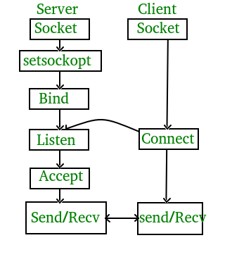
Server-Client Model

Slide 13
Socket Creation:
int sockfd = socket(domain, type, protocol);
sockfd: socket descriptor, an integer (like a file-handle) domain: integer, communication domain e.g., AF_INET (IPv4 protocol) , AF_INET6 (IPv6 protocol) type: communication type SOCK_STREAM: TCP(reliable, connection oriented) SOCK_DGRAM: UDP(unreliable, connectionless) protocol: Protocol value for Internet Protocol(IP), which is 0. This is the same number which appears on protocol field in the IP header of a packet.(man protocols for more details)
Implementation of Server-Client Model

Slide 14
Bind:
int bind(int sockfd, const struct sockaddr *addr, socklen_taddrlen);
After creation of the socket, bind function binds the socket to the address and port number specified in addr(custom data structure). In the example code, we bind the server to the local host, hence we use INADDR_ANY to specify the IP address.
Implementation of Server-Client Model

Slide 15
Listen:
int listen(int sockfd, int backlog);
It puts the server socket in a passive mode, where it waits for the client to approach the server to make a connection. The backlog, defines the maximum length to which the queue of pending connections for sockfd may grow. If a connection request arrives when the queue is full, the client may receive an error with an indication of ECONNREFUSED.
Implementation of Server-Client Model

Slide 16
Accept:
int new_socket= accept(int sockfd, struct sockaddr *addr, socklen_t *addrlen);
It extracts the first connection request on the queue of pending connections for the listening socket, sockfd, creates a new connected socket, and returns a new file descriptor referring to that socket. At this point, connection is established between client and server, and they are ready to transfer data.
Connect:
int connect(int sockfd, const struct sockaddr *addr,
socklen_taddrlen);
The connect() system call connects the socket referred to by the file descriptor sockfd to the address specified by addr. Server’s address and port is specified in addr.
Implementation of Server-Client Model

Slide 17
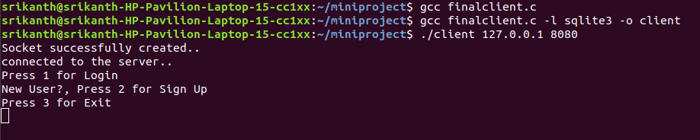
Interfaces
First Interface shown to the client

Slide 18
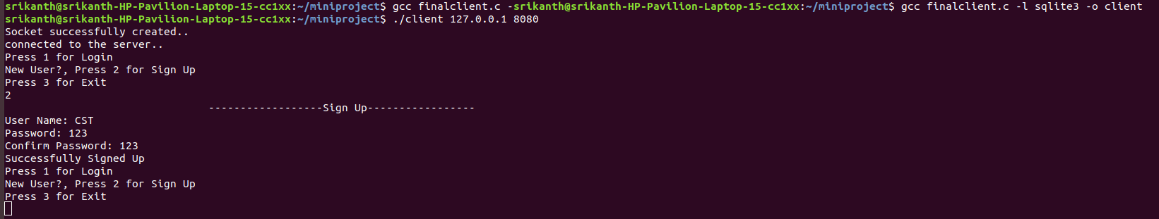
Interfaces
Interface for sign up

Slide 19
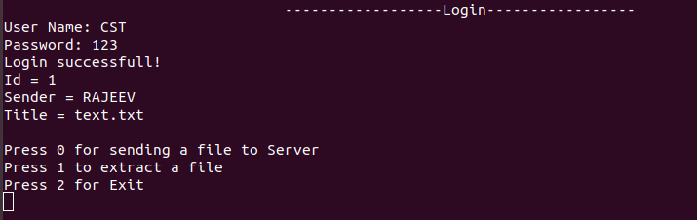
Interfaces
Login Interface

Slide 20
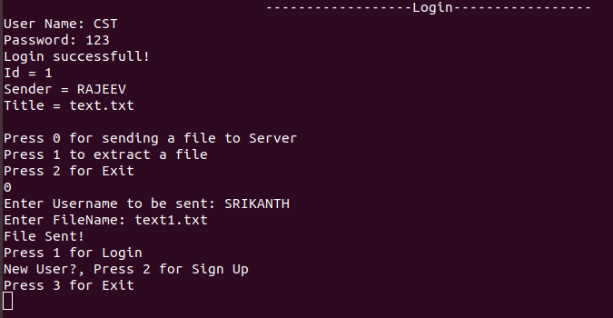
Interfaces
Sending a File

Slide 21
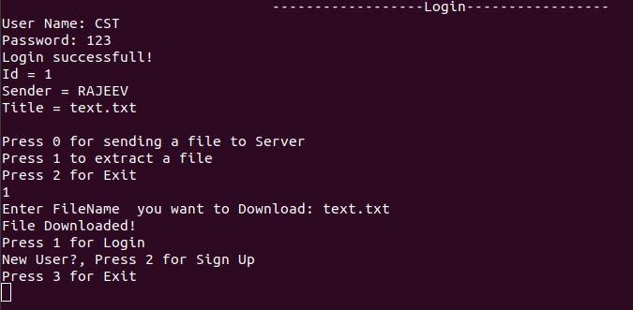
Interfaces
Download a file

Slide 22
Future scope of work
In future we can switch this project to an Android Application.
This Android Application will work as a File Sharing Application which uses Distributive Database.
Further, we can extend this Application as a messaging Application.

Slide 23
Demo

Slide 24
Conclusion
This project is an approach for developing TCP Server-Client Based Distributive File System using C.
Implementation so far we could make in sharing text file through Server-Client Program i.e. Socket Program in C.

Slide 25
References
Wikipedia
https://www.wikipedia.org/
Socket Programming - GeeksforGeeks
https://www.geeksforgeeks.org/tcp-server-client-implementation-in-c/
Sqlite3 – Tutorials Point
https://www.tutorialspoint.com/sqlite/sqlite_ccpp.htm

Slide 26
THANK YOU

